Slide 1

MSPM’S
Deogiri Institute of Engineering and Management Studies,
Aurangabad
Department of Computer Science and Engineering
Subject:Theory of computation
Topic: Write a program to Implement DFA of regular Expression
Submitted by
Mohan . R . Prasad(36153)
Mamta .R. Bagde(36154)
Under the Guidance of
Prof. Sarika Chavan
Asst.Prof.Department of CSE
(Deogiri Institute Engineering and Management Studies)
2019-2020

Slide 2
Introduction
Deterministic Finite Automata (DFA) is The machine can exist in only one state at any given time.
A regular expression is a sequence of characters that define a search pattern, mainly for use in pattern matching with strings, or string matching

Slide 3
Implementation
• A DFA can be implemented by a 2D array T
– One dimension is “states”
– Other dimension is “input symbols”

Slide 4
Approaches
There are 3 steps involve which results in acceptance of string:
Construct FA for a+aa* means having even number of a’s.
Construct FA for b means having any number of b’s.
Concatenate the two FA and make single DFA.
Any other combination result is the rejection of the input string.

Slide 5
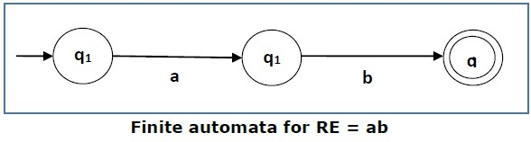
For a regular expression ab, we can construct the following FA

Slide 6
Some RE Examples
Regular Expressions | Regular Set
(0 + 10*) | L = { 0, 1, 10, 100, 1000, 10000, … }
(0*10*) | L = {1, 01, 10, 010, 0010, …}
(0 + ε)(1 + ε) | L = {ε, 0, 1, 01}
(a+b)* | Set of strings of a’s and b’s of any length including the null string. So L = { ε, a, b, aa , ab , bb , ba, aaa…….}
(a+b)*abb | Set of strings of a’s and b’s ending with the string abb. So L = {abb, aabb, babb, aaabb, ababb, …………..}

Slide 7
Language Accepted by DFA
A string w is accepted by a DFA < Q , , q₀ , , A > , if and only if ∂*( q₀ , w )€ A . That is a string is accepted by a DFA if and only if the DFA starting at the initial state ends in an accepting state after reading the string.

Slide 8
program
#include<stdio.h>
#include<string.h>
#include<stdlib.h>
void main() {
int arr[2][2],i,j,l,flag=0,s;
char input[100];
printf("Implmenting DFA of regular expression (a+aa*b)*\n\n\nEnter Input String \n");
arr[0][0]=1;
arr[0][1]=-1;
arr[1][0]=1;
arr[1][1]=0;
scanf("%s",input);
l=strlen(input);
for (i=0;i<l;i++) {
if(input[i]!='a'&&input[i]!='b') {
printf("Value entered is wrong\n");
exit(0); }
if(input[i]=='a'){
flag=arr[flag][0];
printf(“q%d %d\n",i,flag);}
else{
flag=arr[flag][1];
printf(“q%d%d\n“,i,flag);}
if(flag==-1) {
printf("String not Accepted by this expression\n");
break; } }
if(i==l)
printf("String Accepted\n");
//getch();

Slide 9
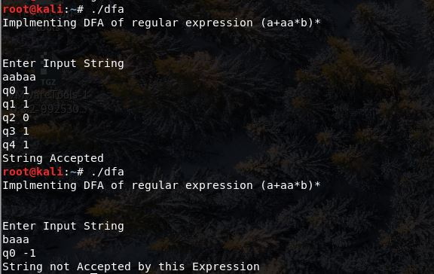
output

Slide 10
conclusion
Hence we have to implement DFA of regular expression in C programming language.

Slide 11

Thank You

